Slide 1

MIT School of Engineering & Sciences, Pune
Department of Electronics and Communication Engineering
“TrackShield”
Group Code: ECO2526UGMP2
Topic: New
Roll No. | Div. | Enrolment No. | Name of Student
D2513024004 | SY ECO | ADT25SESBD047 | Isha Ladhe
D2513024011 | SY ECO | ADT25SESBD050 | Om Sone
D2513024016 | SY ECO | ADT25SESBD052 | Pranav Naik
D2513024015 | SY ECO | ADT25SESBD048 | Krishna Konkewar
Name of Guide: Prof. Manali Raut
Name of Co-guide / Industry Mentor (if any) | Name, Name of Industry

Slide 2
Contents
Introduction
Problem Statement
Objectives
Circuit Diagram for MP-I / Block diagram for MP-II, III & Major Project
Discussion on Circuit/Block diagram
Work plan till next presentation
Conclusion
References

Slide 3
Introduction
TrackShield is a smart wearable safety and tracking system designed to protect children and vulnerable individuals.
It helps parents and caregivers monitor the location of their children in real time.In today’s busy world, children can easily get lost or enter unsafe areas.
Traditional safety methods like supervision or ID tags are not always reliable in crowded places.
TrackShield uses modern technologies such as GPS, GSM, and Bluetooth Low Energy (BLE) to track location.The system can send alerts to guardians during emergencies.
TrackShield helps improve safety and gives peace of mind to parents and caregivers.
It provides a cost-effective, reliable, and real-time safety solution.

Slide 4
Problem Statement
To develop a smart safety and tracking system for children and vulnerable individuals. Today, because of busy lifestyles and crowded places, it is difficult for parents to always monitor their children. Traditional safety methods like supervision, ID tags, or phone calls are not always reliable in emergencies. Many existing tracking systems also have problems like high power use and limited features. Therefore, a smart, reliable, and low-cost system is needed to track a child’s location and quickly alert parents if the child is in danger or leaves a safe area.

Slide 5
Objectives
To develop a smart wearable device for safety and location tracking.
To implement real-time location tracking using GPS technology.
To send location updates and alerts to parents/guardians using GSM communication.
To include an SOS emergency alert feature for quick help during danger.
To design a low-cost and reliable IoT-based safety solution for monitoring individuals.

Slide 6
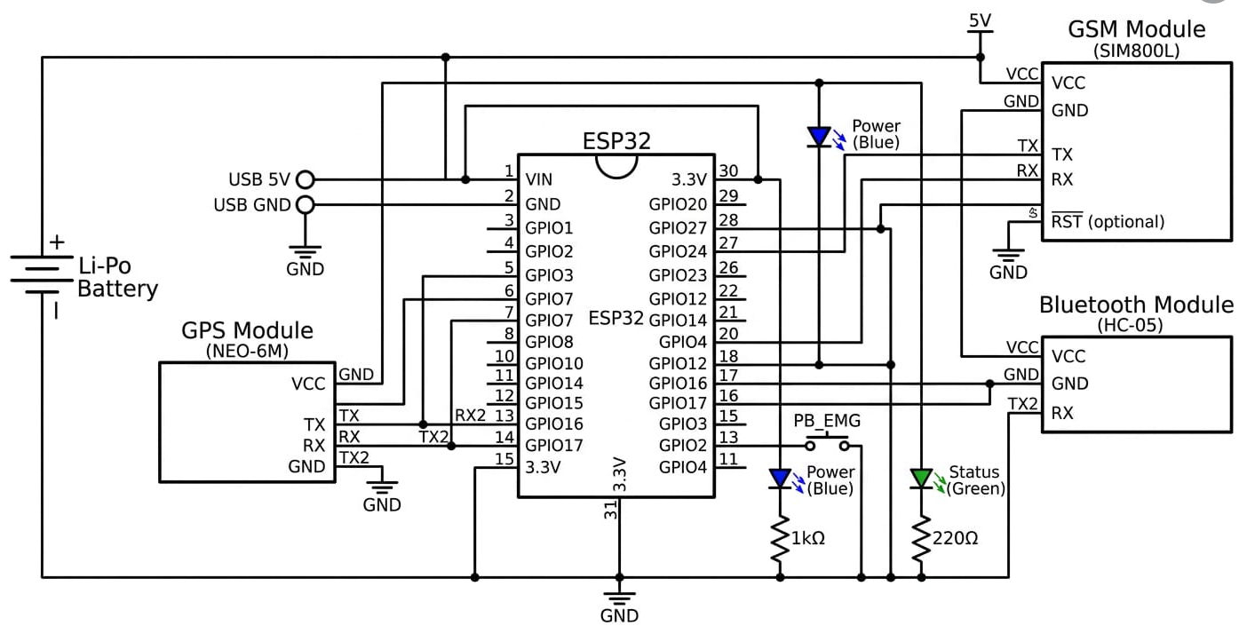
Circuit/Block diagram

Slide 7
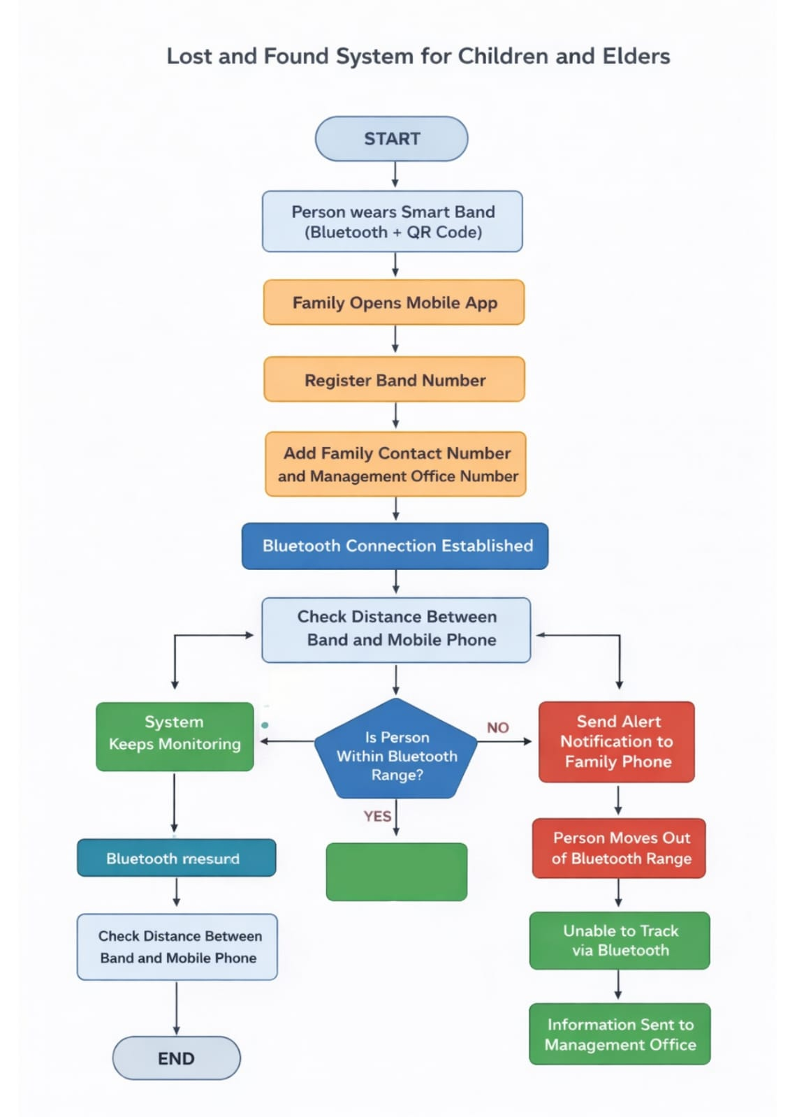
Flowchart
Person is safe

Slide 8
Discussion on Circuit/Block diagram
The system starts when a child or elderly person wears a smart band with Bluetooth and QR code.
The family member opens the mobile application to monitor the person.
The band number is registered in the mobile app for identification.
The family contact number and management office number are added in the system.
A Bluetooth connection is established between the smart band and the mobile phone.
The system continuously checks the distance between the band and the mobile phone.
If the person remains within the Bluetooth range, the system keeps monitoring and the person is safe
If the person moves outside the Bluetooth range, the system sends an alert notification to the family phone.
After that, the management office is also informed to help locate the person.
If the person is out of the range and the guardian is not alterted due to some issues, there will be the Qrcode on the band.
By scanning that QR code the person scanning it will get the information of the guardian and the management office.
This system helps in quick detection and recovery of lost children or elderly people in crowded places.

Slide 9
Work plan Till next presentation
In this presentation, we will show the QR code part of our Lost and Found System.
The QR code is placed on the smart band and contains the family contact details.
If the person gets lost, anyone can scan the QR code and inform the family, helping the person return safely.
In the next presentation, we will present the Bluetooth monitoring part of the system.
In this module, the smart band will be connected to the guardian’s mobile phone through Bluetooth.
The system will continuously monitor the distance between the band and the mobile phone.
If the person moves outside the safe Bluetooth range, the system will automatically send an alert notification to the family member.
This feature works as a precautionary measure and helps the guardian take action before the person actually gets lost.
Together, these modules will make the system more effective in ensuring safety in crowded places.

Slide 10
Conclusion
The smart safety and tracking system helps improve the safety of children and vulnerable individuals. It uses technologies like GPS, GSM, and BLE to track location and send alerts in emergencies. This system is reliable, cost-effective, and provides real-time monitoring, giving parents and caregivers better security and peace of mind.

Slide 11
Refrences
Smart Wearable Iot Device For Child Safety And Location Tracking
https://www.ijcrt.org/papers/IJCRT2505697.pdf?utm_source=chatgpt.com
Design of BLE Based Child Tracking Device
https://www.ijresm.com/Vol.2_2019/Vol2_Iss3_March19/IJRESM_V2_I3_152.pdf?utm_source=chatgpt.com
IEEE https://ieeexplore.ieee.org
BLE Bluetooth Beacon based Solution to Monitor Alzheimer Patients
https://www.researchgate.net/publication/339543310_BLE_Bluetooth_Beacon_based_Solution_to_Monitor_Egress_of_Alzheimer%27s_Disease_Sufferers_from_Indoors?utm_source=chatgpt.com
Monitoring Wandering Behavior of Persons with Dementia Using BLE
https://arxiv.org/abs/2403.19704

Slide 12
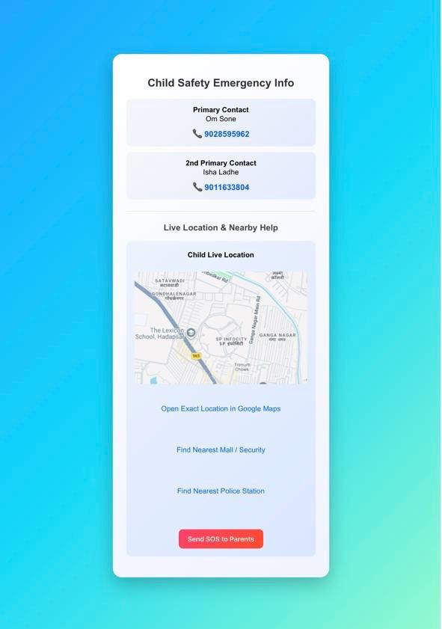
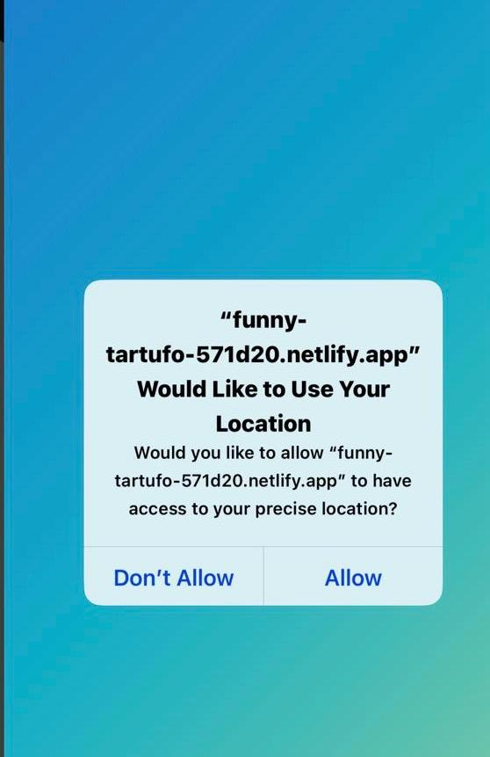
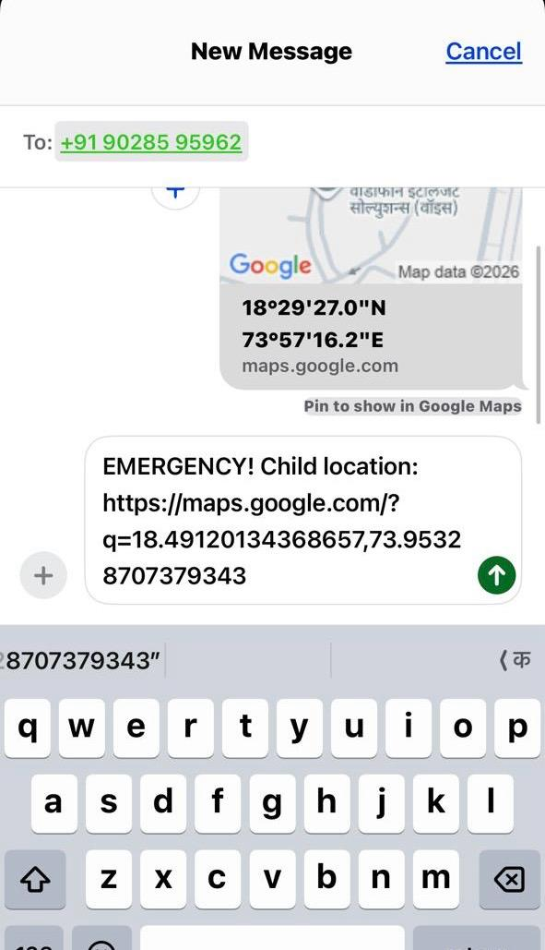
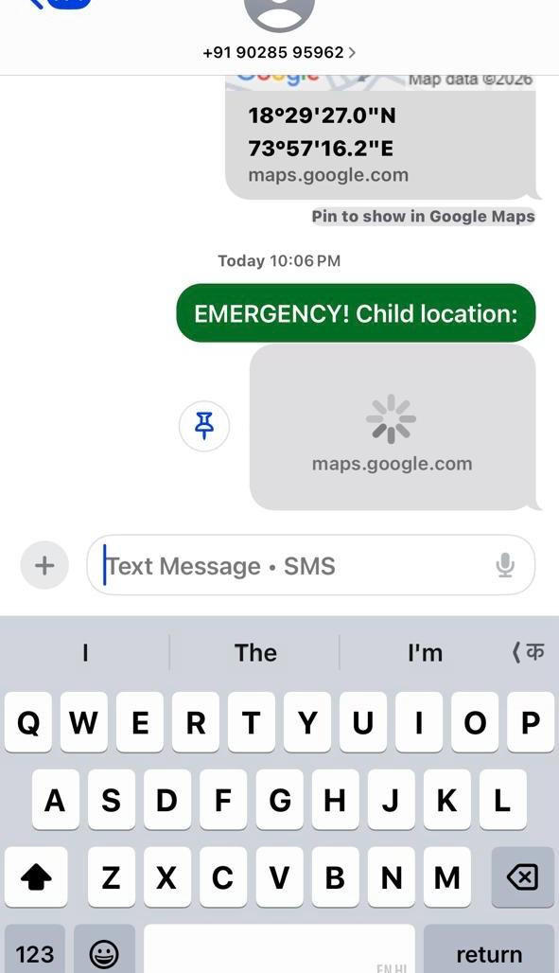
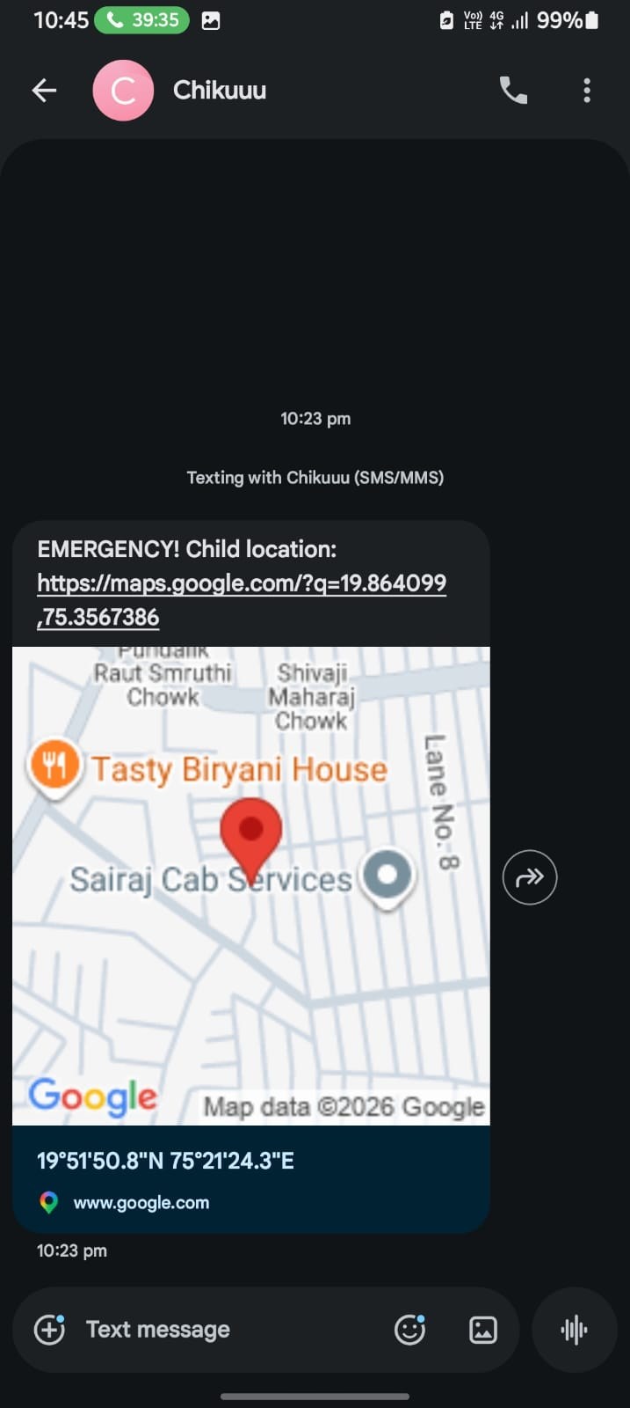
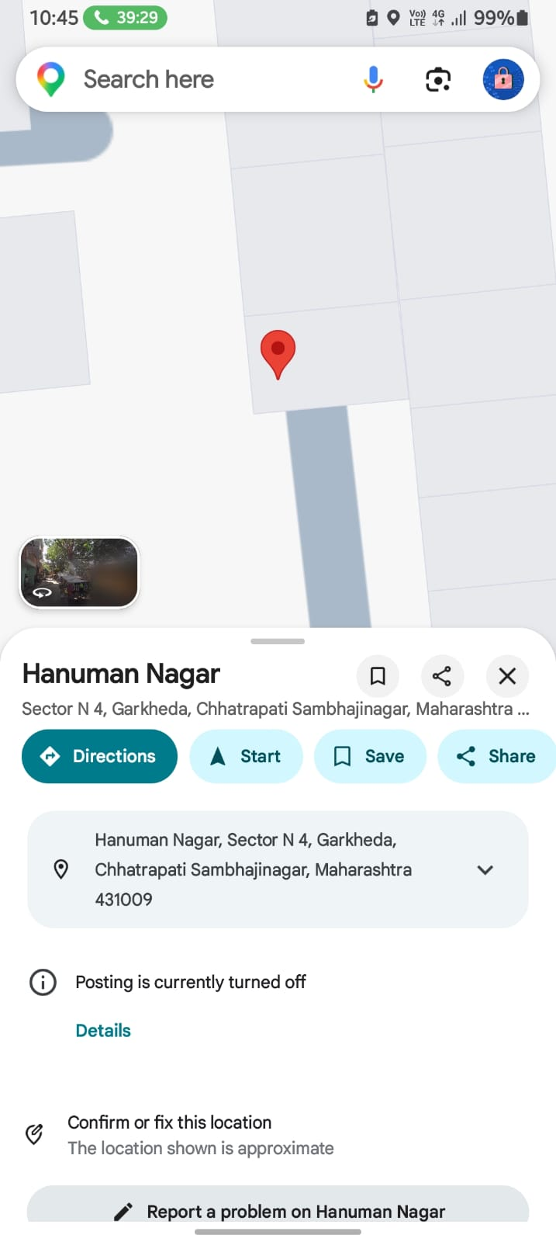
Output

Slide 13
